Slide 1
ecbi
Who Will Fill the Gap?
California’s Pledge for Being ‘In’
A mapping of the CA-to-Paris Context
Emilie C. Parry emilie.parry@ouce.ox.ac.uk
University of Oxford Centre for the Environment
School of Geography & the Environment
Associate Fellow, Oxford Climate Policy
european capacity building initiative
initiative européenne de renforcement des capacités
for sustained capacity building in support of international climate change negotiations
pour un renforcement durable des capacités en appui aux négociations internationales sur les changements climatiques

Slide 2
Headings
Mapping of Climate Actors / Context of California’s Paris Commitments
II. Oxford Climate Policy’s proposed conceptual strategies for Californian contributions to Paris Climate Finance
III. Opportunities and Potential

Slide 3
Sacramento: California Environmental Protection Agency; Matt Rodriquez, Secretary for Environmental Protection; Alexa Kleysteuber, deputy secretary for border and intergovernmental relations, California EPA
San Francisco: CA Climate Alliance; Climate Justice & Environmental Justice groups
Oakland: Aimee Barnes, advisor to the Governor ; Ken Alex Director of the Governor’s Office of Planning and Research, and serves as Senior Policy Advisor to Governor Jerry Brown and the Chair of the Strategic Growth
Google
Southwest and downtown Fresno; Transformative Climate Communities Program; Fresno Participatory Community Steering Committee; Metro Ministry; Luisa Medina; CVAQ (Central Valley Air Quality Coalition)
Los Angeles Mayor Eric Garcetti; CA Climate Mayors Network; Matt Peterson, La Kretz Innovation Campus
Daniela Simunovic, Senior Program Analyst, California Strategic Growth Council
Chair, California Air Resources Board Mary Nichols;
Santa Monica Mayor Ted Winterer; California Climate Mayors Network; Dean Kubani, Head of Santa Monica City’s Sustainability & Environment initiatives; Former Assemblyman, CARB Gov. Brown-appointee Hector de la Torre; Ebert, Climate Action Reserve

Slide 4
California Environmental Protection Agency (CalEPA)
Executive Management
Source: CalEPA (accessed July 2017): http://calepa.ca.gov/About/Bios/

Slide 6
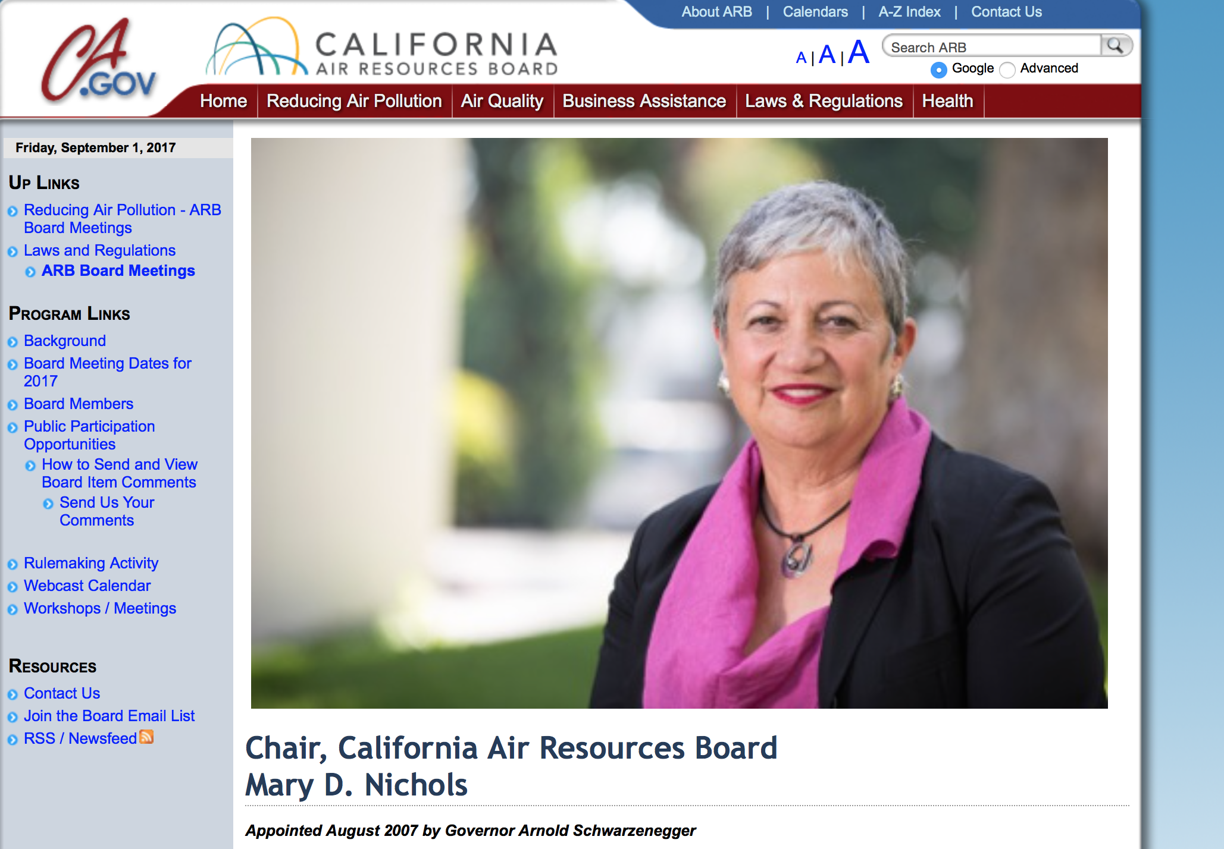
California Air Resources Board (CARB)

Slide 7
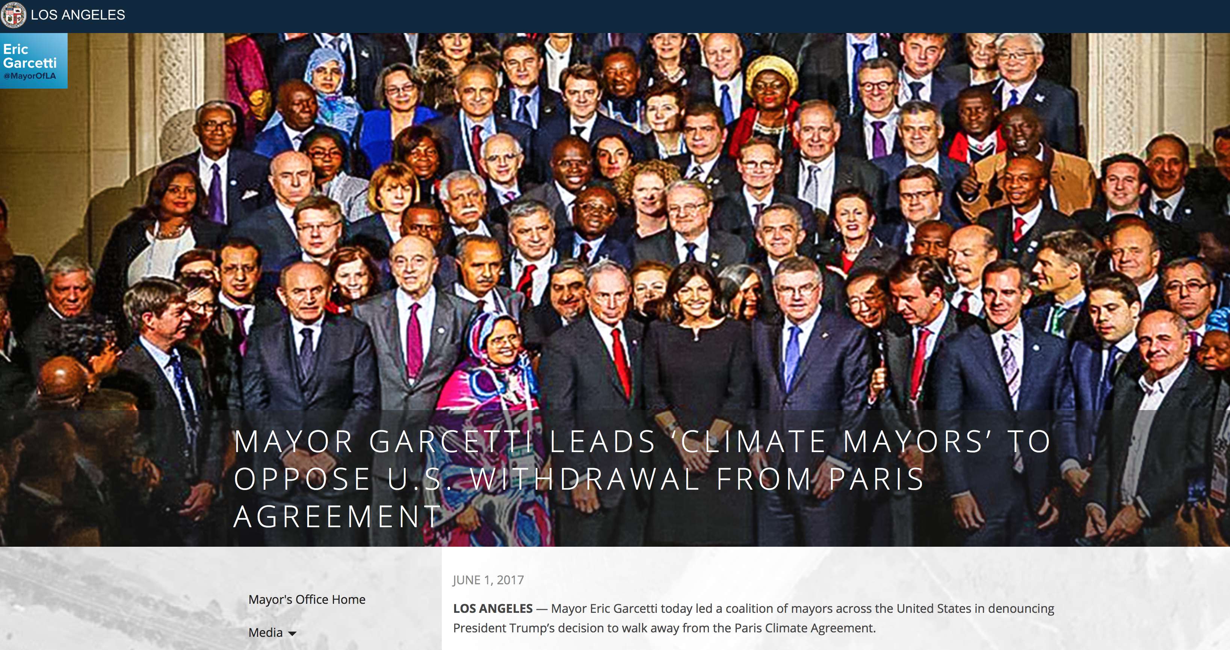
CALIFORNIA MAYORS NETWORK
Compact of Mayors
Source: https://www.lamayor.org/mayor-garcetti-leads-‘climate-mayors’-oppose-us-withdrawal-paris-agreement

Slide 8
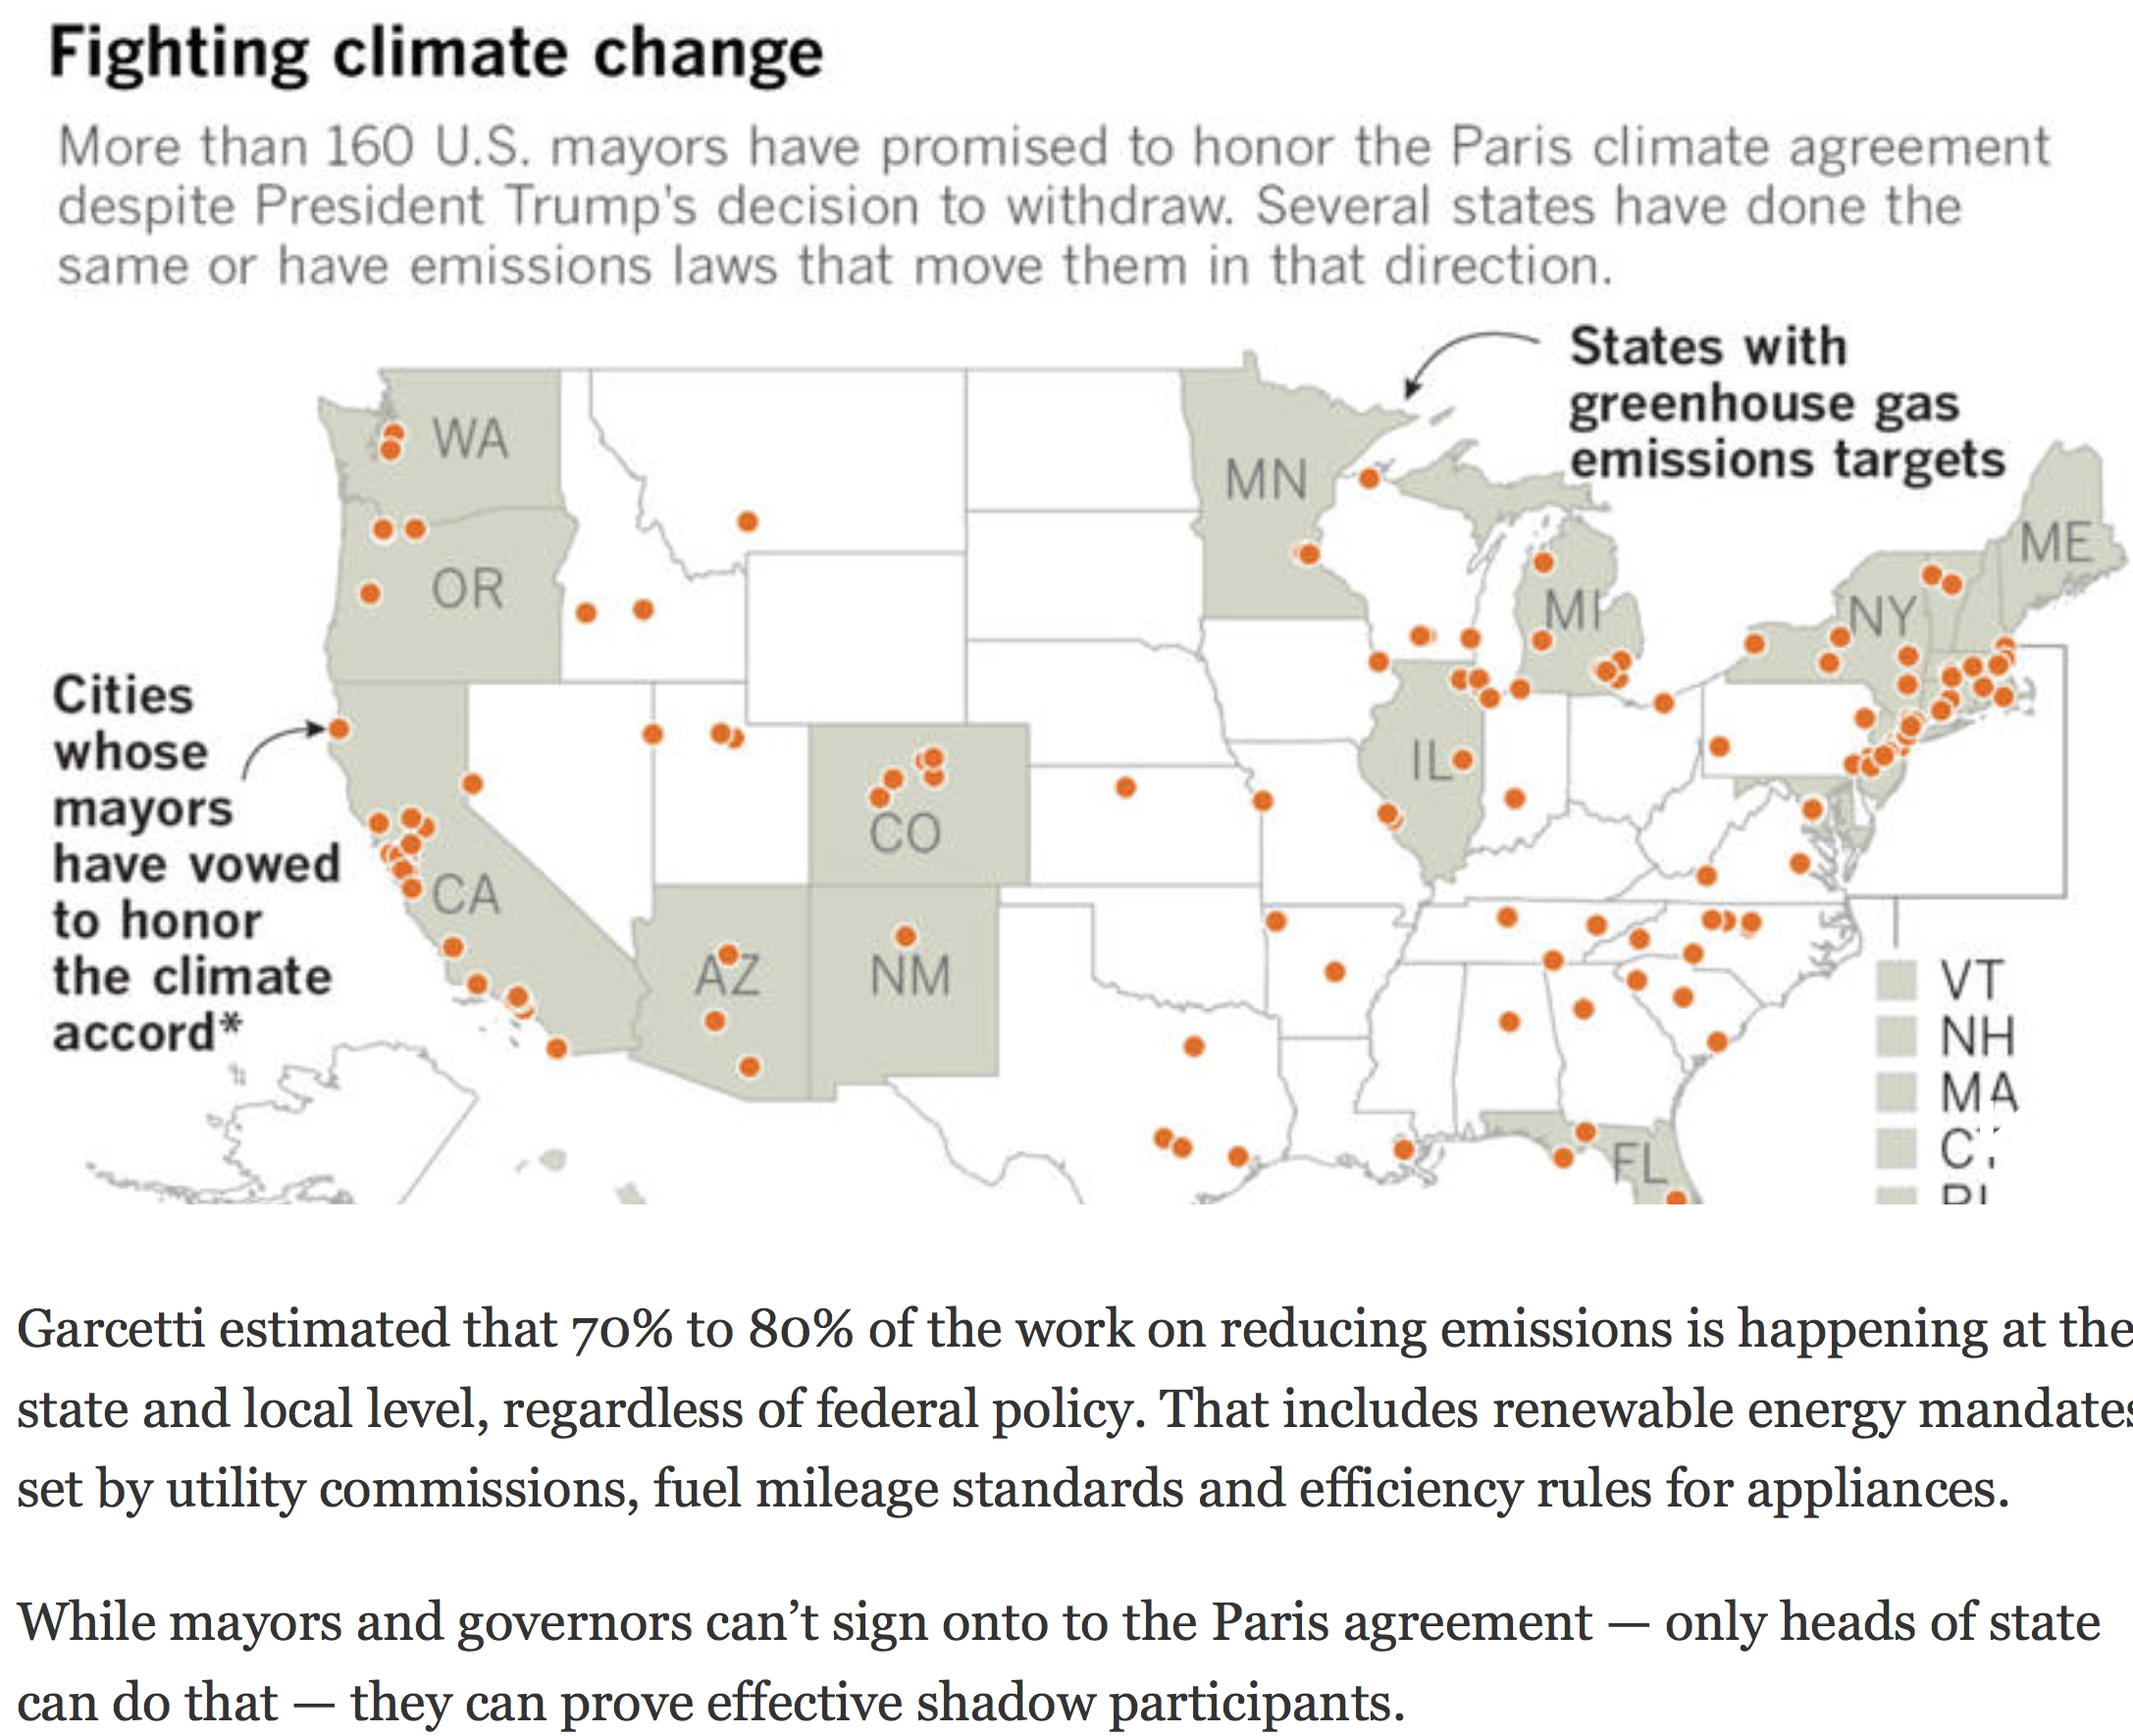
Source: LA Times, June 2, 2017

Slide 9
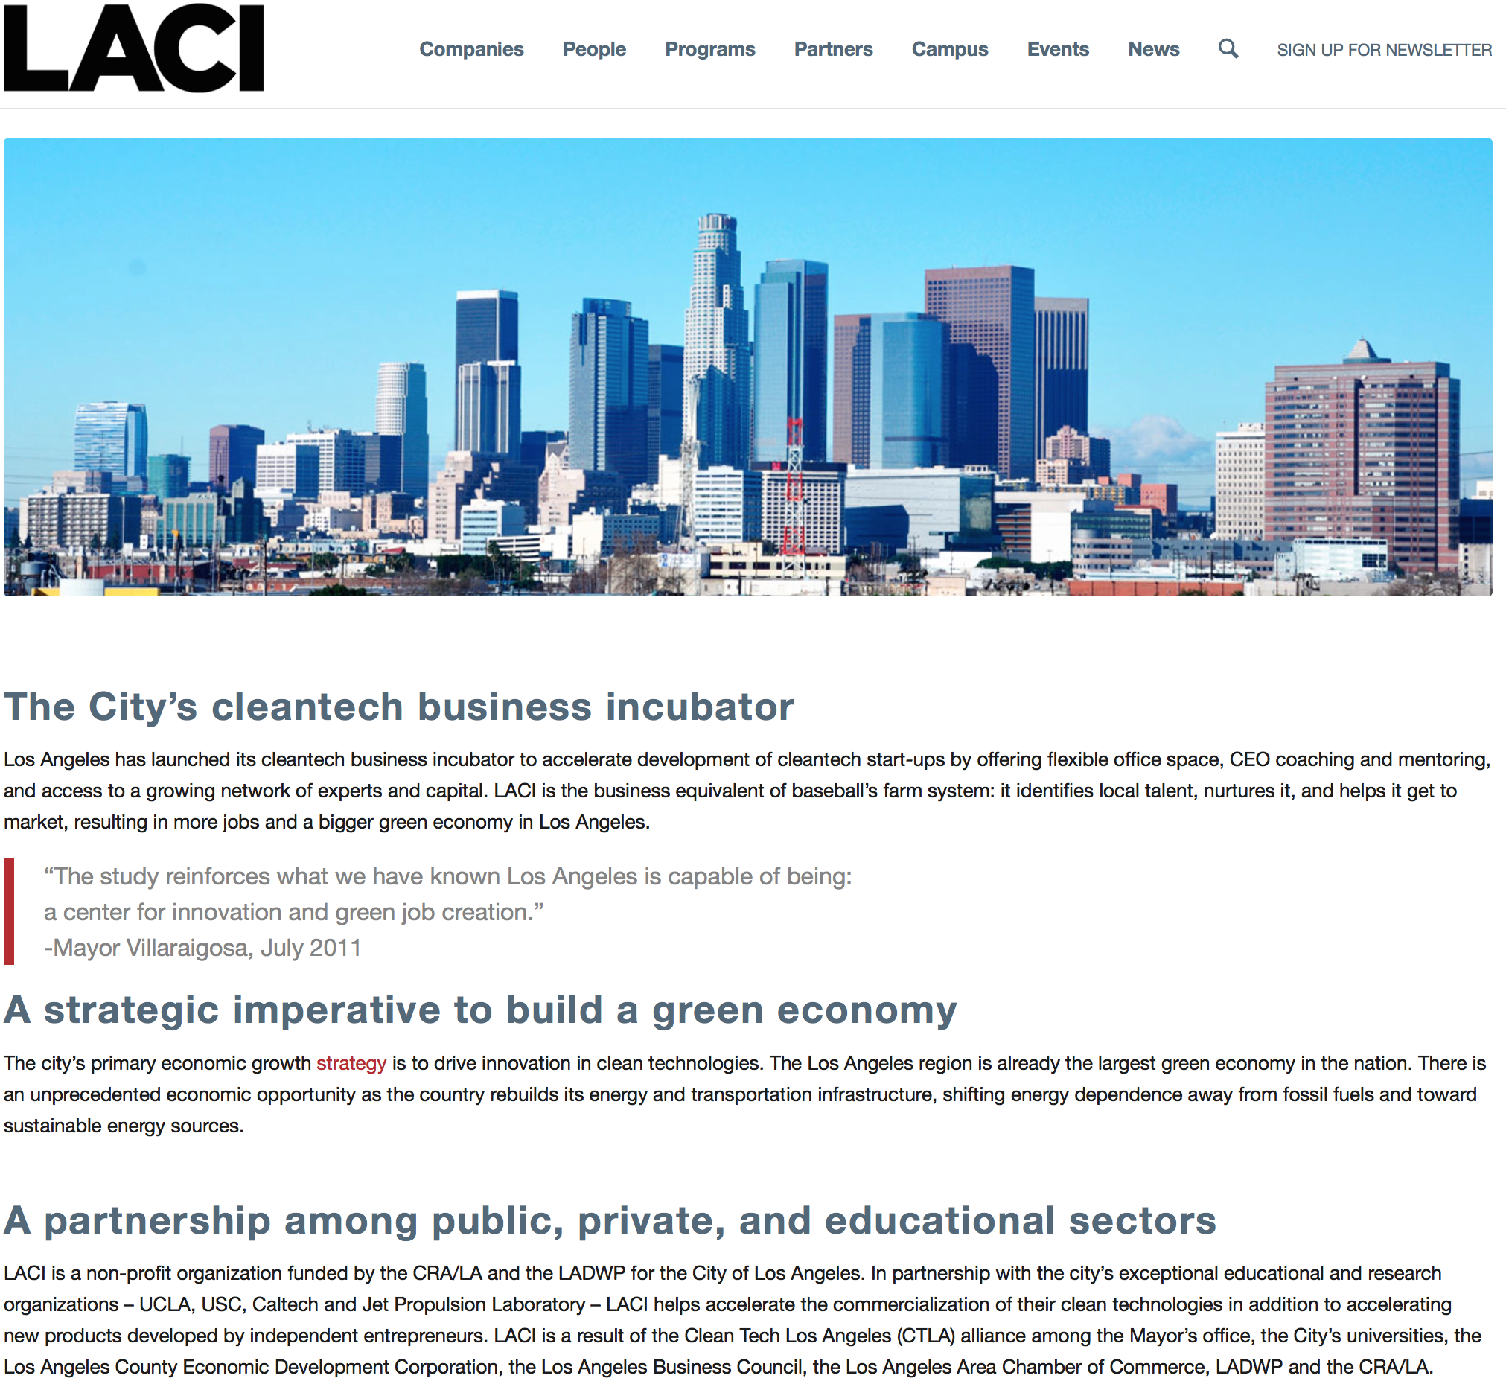

Slide 10
Oxford Climate Policy Climate Finance Strategies for Californian contributions to the LDCF (Least Developed Countries Fund) or the UN Adaptation:
gov’t supported crowdfunding (UN Adaptation Fund), facilitation of connections between financiers and LDC climate actors
Cap & Trade / Cap & Dividend
Utilities Auction

Slide 11
Governor Brown:
“Taking the place of the President” on Climate Change?
Special U.S. Envoy to COP23
China trip 1 day after Trump announced US withdrawal from the Paris Agreement
Views climate action coalition will grow stronger in response (Galvanized by this announcement);
Jobs created by new economy / clean tech
“We are doing the Paris Agreement and our job numbers are over 2 million (2 million new jobs?) in clean tech and sustainable infrastructure” – Gov. Brown

Slide 12
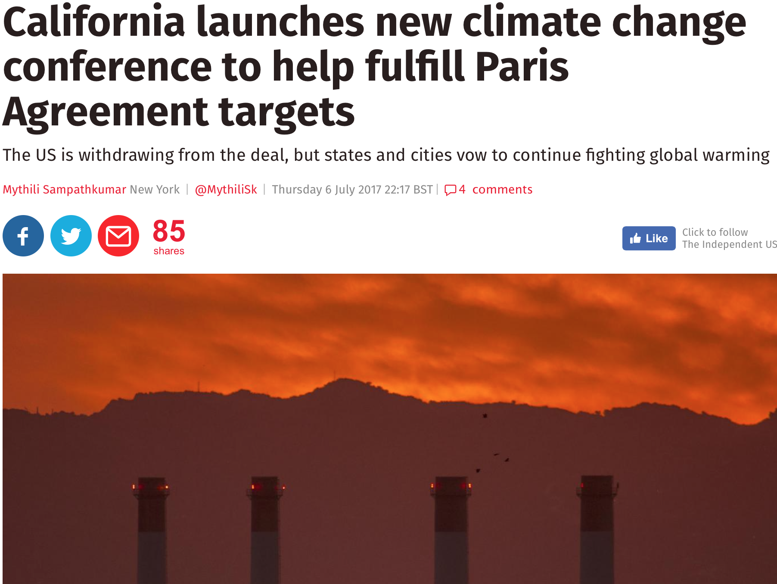
California September 2018 Climate Change Summit
Source: The Independent, July 2017

Slide 13
Opportunities, challenges, potential strategy
2018 California Climate Summit in the Bay Area
Cap & dividend or other state revenue
Utilities auction
Market based solutions (LACI and others)
Private funders contributing to UN Adaptation Fund, LDCF
And other direct private to nations / private to IGO/UN donations
(such as Bloomberg)

